Slide 1
Map() and Filter()
Using Python functions

Slide 2
Lambda (Anonymous) Functions
The following terms may be used interchangeably depending on the programming language type and culture:
Anonymous functions
Lambda functions
Lambda expressions
Lambda abstractions
Lambda form
Function literals
Lambda functions are defined with the structure:
lambda x: x+1
Where x is the bound variable, a colon and then the body of the function/expression.
6 Minute video that describes Lambdas:
https://youtu.be/25ovCm9jKfA

Slide 3
map()

Slide 4
map() from https://docs.python.org/3/library/functions.html#map
map(function, iterable, ...)
Return an iterator that applies function to every item of iterable, yielding the results. If additional iterable arguments are passed, function must take that many arguments and is applied to the items from all iterables in parallel. With multiple iterables, the iterator stops when the shortest iterable is exhausted. For cases where the function inputs are already arranged into argument tuples, see itertools.starmap().

Slide 5
filter()

Slide 6
filter() from https://docs.python.org/3/library/functions.html#filter
filter(function, iterable)
Construct an iterator from those elements of iterable for which function returns true. iterable may be either a sequence, a container which supports iteration, or an iterator. If function is None, the identity function is assumed, that is, all elements of iterable that are false are removed.
Note that filter(function, iterable) is equivalent to the generator expression (item for item in iterable if function(item)) if function is not None and (item for item in iterable if item) if function is None.
See itertools.filterfalse() for the complementary function that returns elements of iterable for which function returns false.

Slide 7
Differences in Python 2 versus Python 3
filter()
In Python 2 using filter() will automatically return a list of the values whereas in Python 3 using filter only returns an iterable object instead of the actual list.
In order to have the function work to deliver a list, you have to wrap it in a list() constructor.
map()
For map() it is a similar change where the function will return the iterator and if you wanted to generate a list of the results you would have to wrap the function in a list() constructor.
.

Slide 8
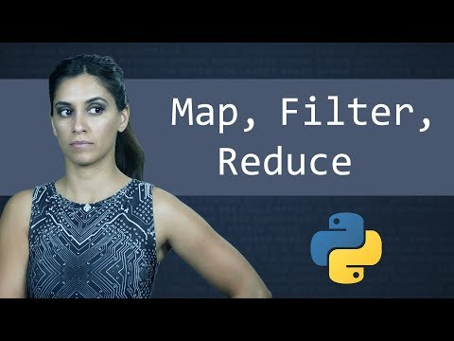
Examples of use
This video goes over examples of how to use the map and filter functions.
It does also go over reduce, but there is a comment in the video as to the lower overall usage of reduce given that a for loop is easier to read and of course:
“Explicit is better than implicit”

